Slide 1
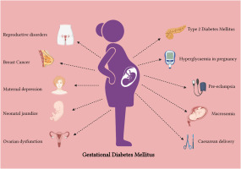
Advancing Early Diagnosis of Gestational Diabetes
Presenting By: Surekha Dhulipalla, Veena Chebrolu, Ramya reddy baapathu, Swaikshya Nepal, Neha Sri Tella
Saint Louis University

Slide 2

Table of contents
Introduction
Data Description
Data Attributes
Select the features.
Linear Regression.
Profiling
Parallelization with Dask
Random Forest
Genetic Algorithm
Dask Computing
Conclusion
Reference
Contribution

Slide 3
Introduction:
Our project uses machine learning models and statistical methods to identify key features from patient health data that can help in the early prediction of gestational diabetes. This approach aims to assist healthcare professionals in making timely decisions during pregnancy.

Slide 4
Data Description
Diabetes Prediction Dataset
Source: Kaggle
Link: https://www.kaggle.com/datasets/akshaydattatraykhare/diabetes-dataset
Number of Records: 768
Description: By examining different health parameters, this dataset helps in determining if a person has diabetes.
Features: features such as glucose levels, blood pressure, skin thickness, insulin, BMI, age, and Outcome.
Objective: The primary goal is to use these medical characteristics to advance early diagnosis of gestational diabetes in patients.

Slide 5
Data Attributes – Name of Columns
Diabetes Prediction Dataset
Pregnancies: Number of times the patient has been pregnant.
Glucose: Plasma glucose concentration a 2 hours in an oral glucose tolerance test.
BloodPressure: Diastolic blood pressure (mm Hg).
SkinThickness: Triceps skinfold thickness (mm).
Insulin: 2-Hour serum insulin (mu U/ml).
BMI: Body mass index (weight in kg/(height in m)^2).
DiabetesPedigreeFunction: A function that scores the likelihood of diabetes based on family history.
Age: Age of the patient in years.
Outcome: Binary variable (0 or 1) indicating whether the patient has diabetes.

Slide 6
Features selection
Based on the dataset attributes, we selected three important features for regression analysis: Glucose – Strongly related to diabetes. BMI – A major factor influencing diabetes risk. Age – Older individuals are more prone to diabetes.

Slide 7
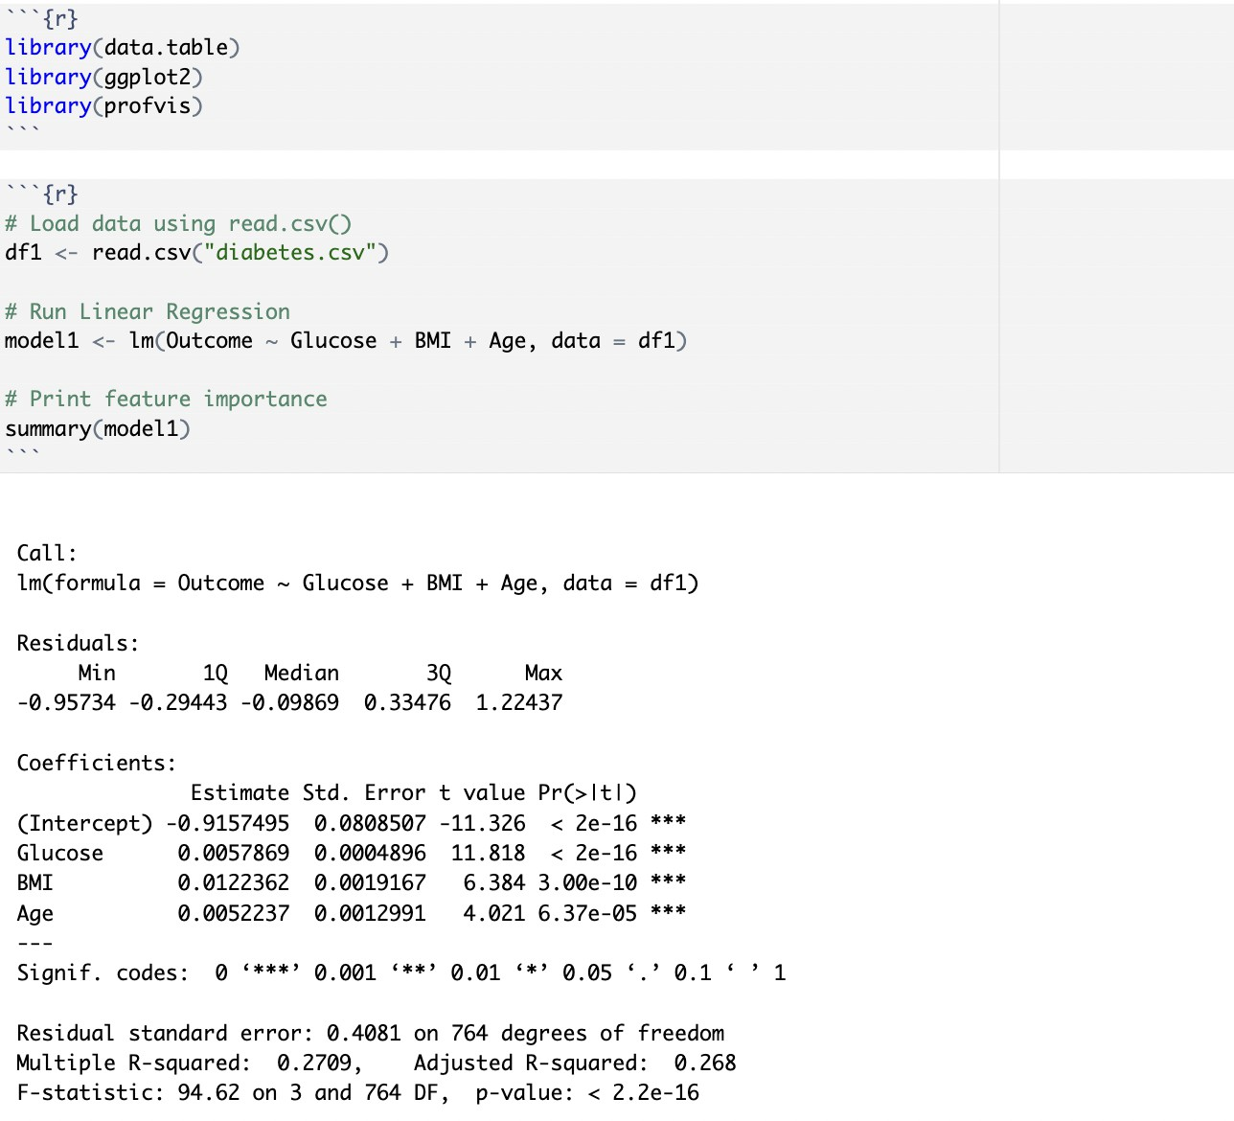
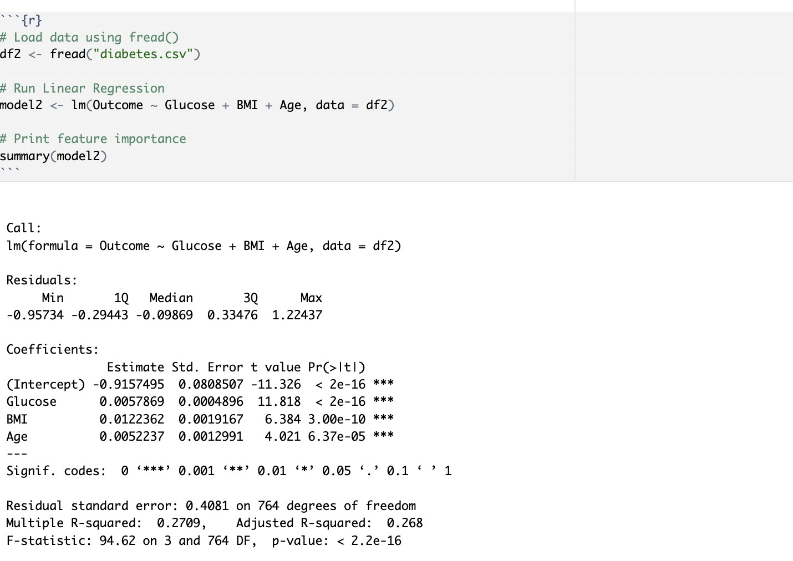
Step 2: Find Feature Importance Using Linear Regression With `read.csv()` and `fread()`.
Interpretation :
The statistical analysis shows Glucose, BMI and Age as important predictors of the outcome which leads to higher outcome values (p < 0.001). Glucose demonstrates the strongest connection to the outcome than BMI with Age operating through a lesser degree. Other factors besides the model variables account for 73% of the outcome variation (R² = 0.2709). The research model demonstrates outstanding importance (p < 0.001) since it confirms that these variables represent key factors. The results show that Glucose, BMI and Age variables together influence the outcome to increase when their individual values are elevated. Both read.csv() and fread() yielded identical results when handling this dataset.

Slide 8
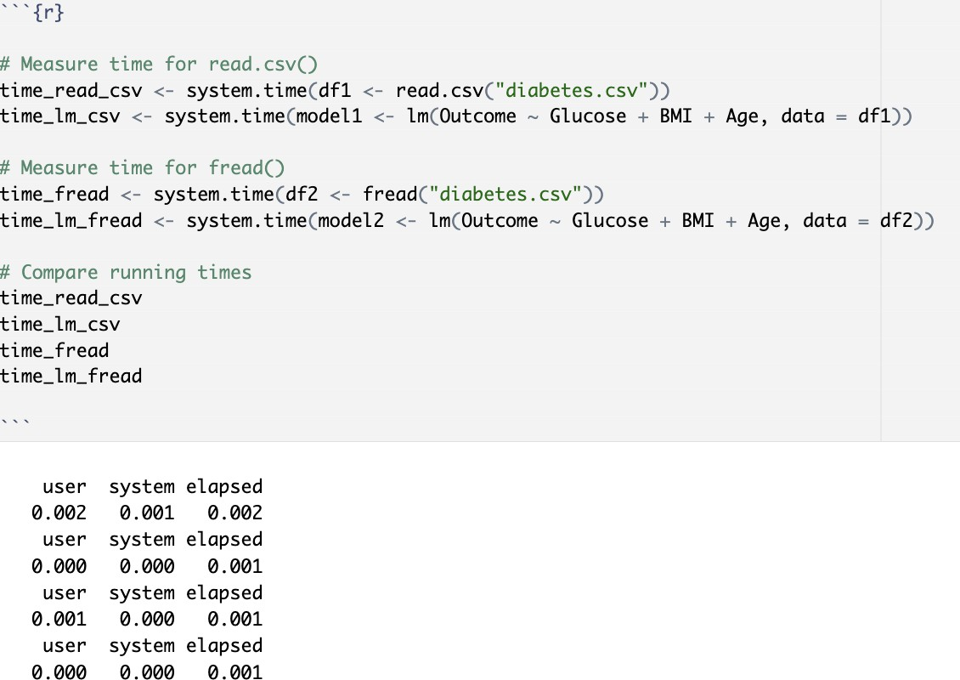
Step 3: Profiling for Performance Optimization Profiling helps identify bottlenecks in execution time.We use `system.time()` to compare the two methods.
Interpretation:
Looking at the system.time() measurements: fread() shows slightly faster data reading times. Reads data in 0.001 seconds vs 0.002 seconds for read.csv(). Both methods take the same time (0.001 seconds) for model fitting. While the difference is small due to the dataset size, fread() demonstrates better performance in reading the data. The model fitting time is same for both methods.

Slide 9
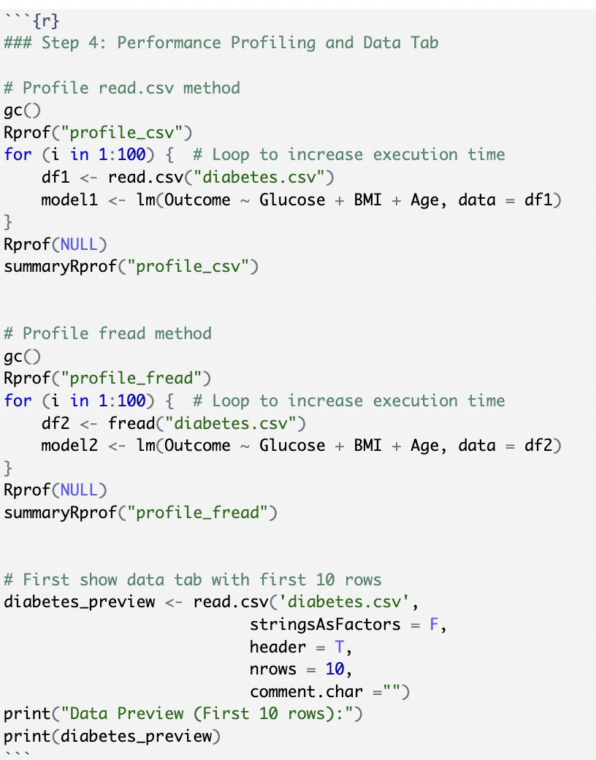
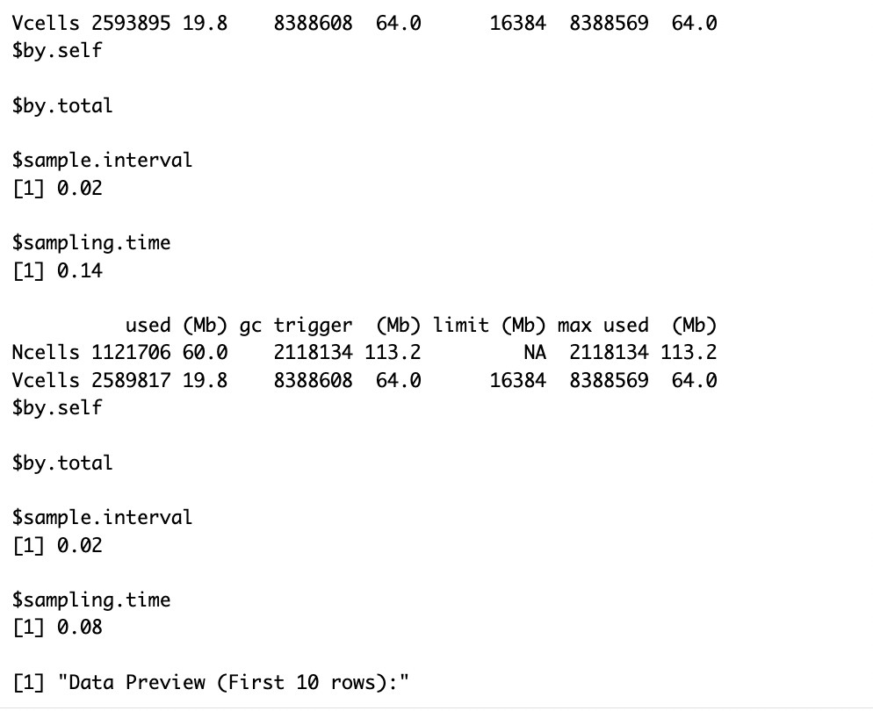
Step4: Performance Profiling and Data Tab
fread() shows better performance with a shorter sampling time (0.08 vs 0.14), while using slightly less memory. Both methods maintain the same sample interval (0.02).

Slide 10
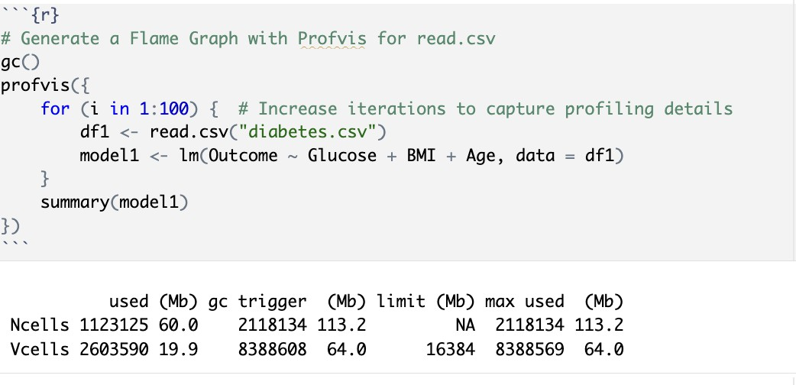
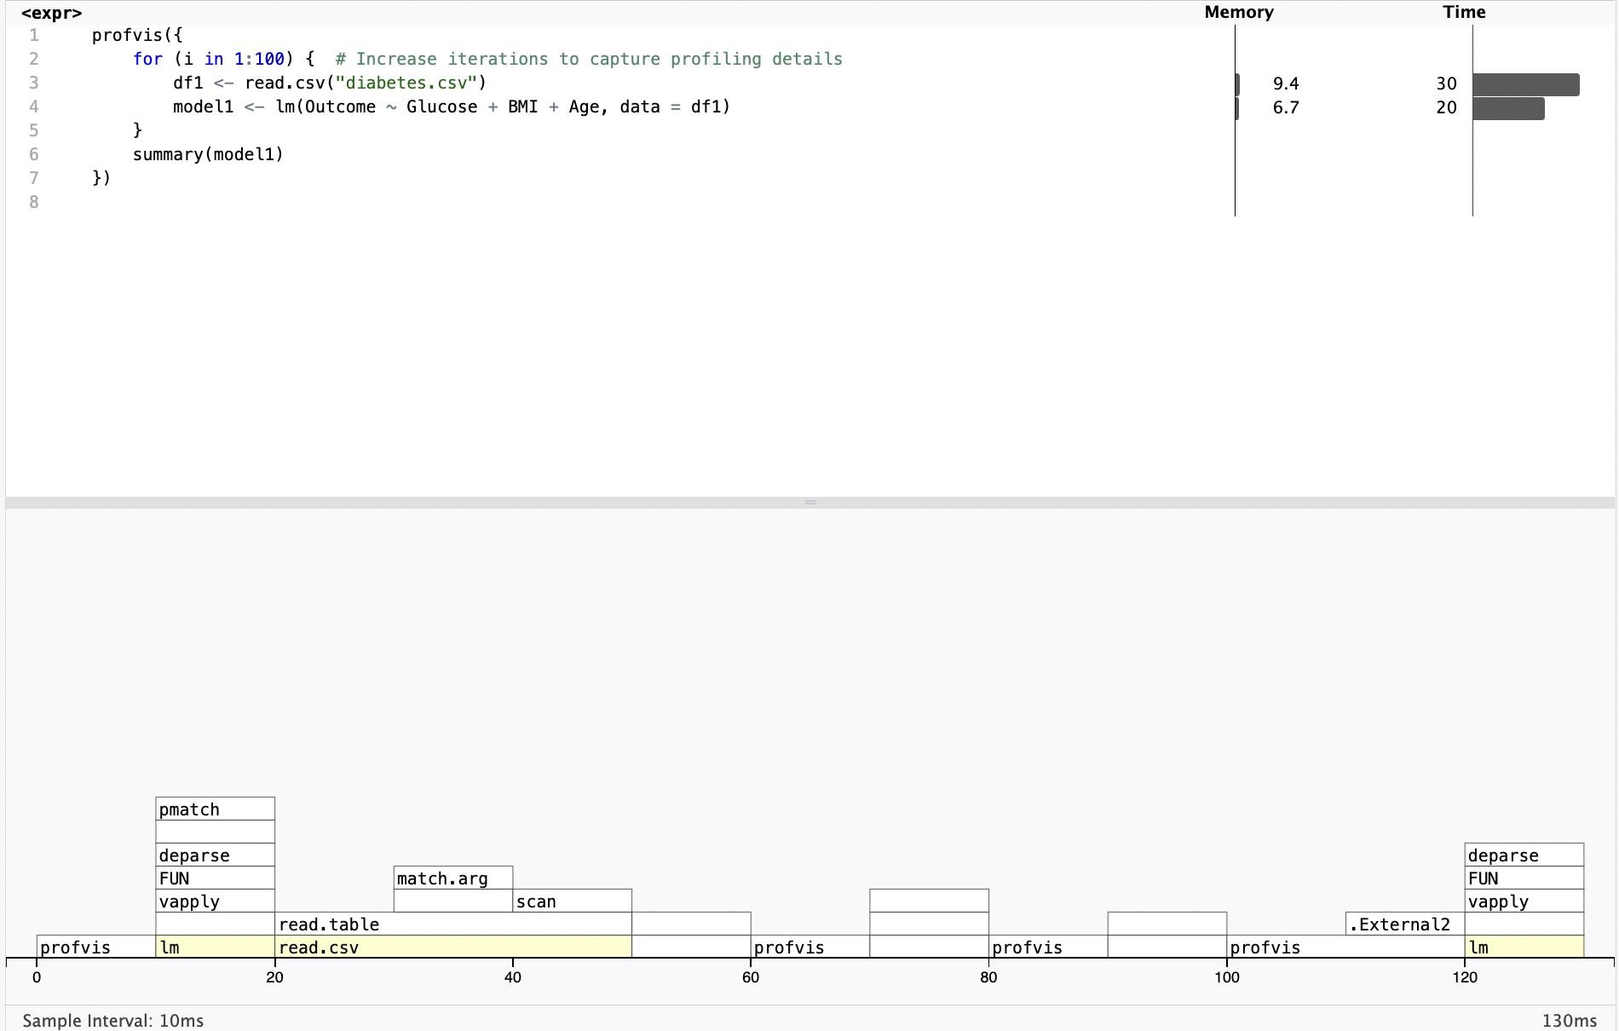
Flame Graph After Profiling For read.csv( )
Total Execution time is 130ms

Slide 11
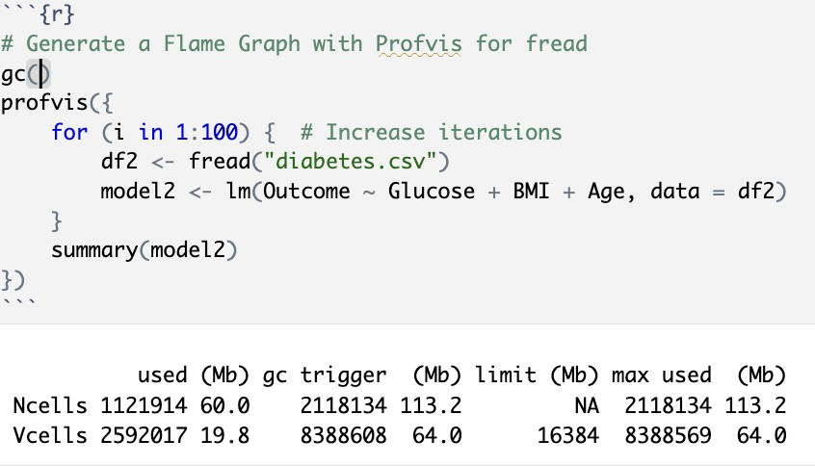
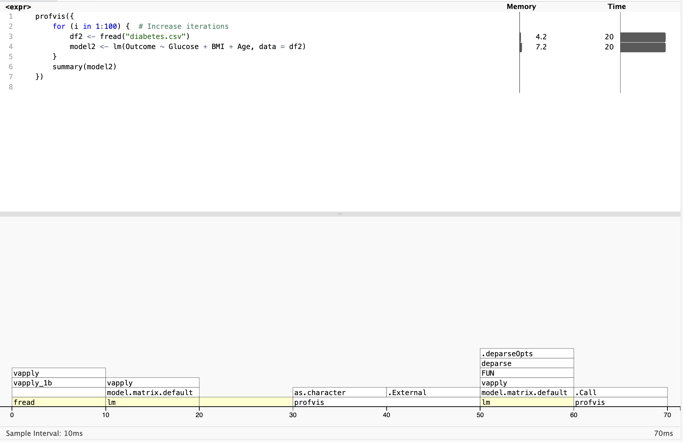
Flame Graph After Profiling With fread( )
Total Execution time is 70ms

Slide 12
WHICH METHOD IS FASTER?
fread() executes data input and model execution tasks faster than the read.csv() method. The total execution time using fread() requires 70ms compared to 130ms for read.csv(). The flame graphs demonstrate that fread() has a more streamlined execution path with fewer intermediate function calls compared to read.csv() which requires additional steps through match.arg, scan, and read.table functions. While both methods successfully perform the linear regression analysis with the same model specification (Outcome ~ Glucose + BMI + Age), fread() accomplishes this more efficiently, making it the optimal choice for processing the diabetes dataset. The memory usage is also more efficient with fread() (4.2-7.2 Mb) compared to read.csv() (6.7-9.4 Mb), further supporting fread() as the preferred method for the analysis.

Slide 13
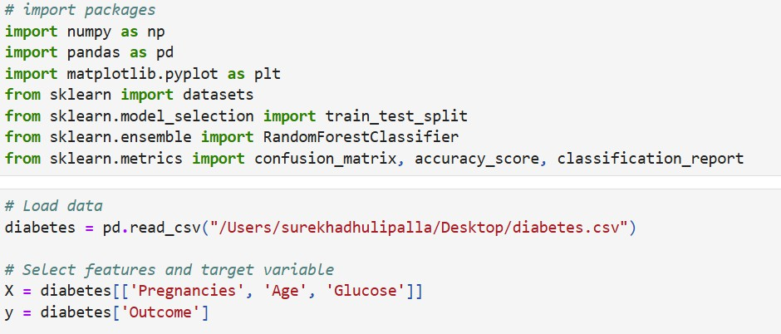
Select 2-3 features as X and one categorial feature for target
We selected pregnancies, age, glucose as x feature and outcome as categorical feature

Slide 14
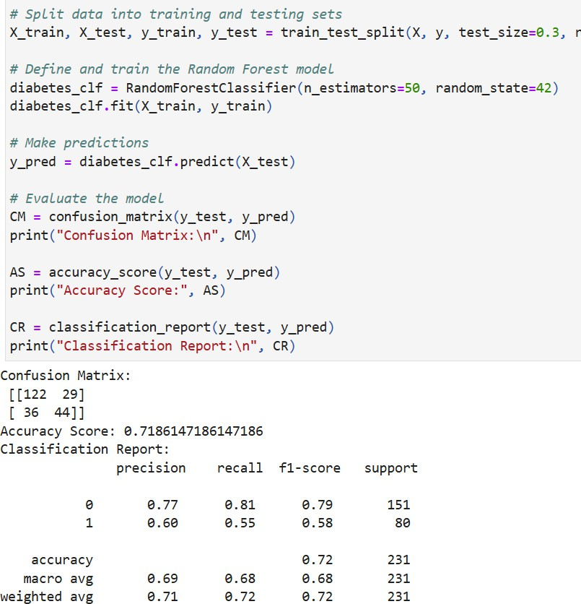
Accuracy of model before Dask
Interpretation:
The model's accuracy is 71.86%, or almost 72% of the time, which is respectable but not flawless. With Class 0 (negative cases), it performs better, catching 81% of the actual negatives (Recall: 81%) and accurately identifying 77% of the ones it predicts as negative (Precision: 77%). With only 60% of its positive predictions coming true (Precision: 60%) and only 55% of all real positives (Recall: 55%), it performs worse in Class 1 (positive cases), suggesting it misses a significant number of them. Overall, the model tends to be good at recognizing negatives.

Slide 15
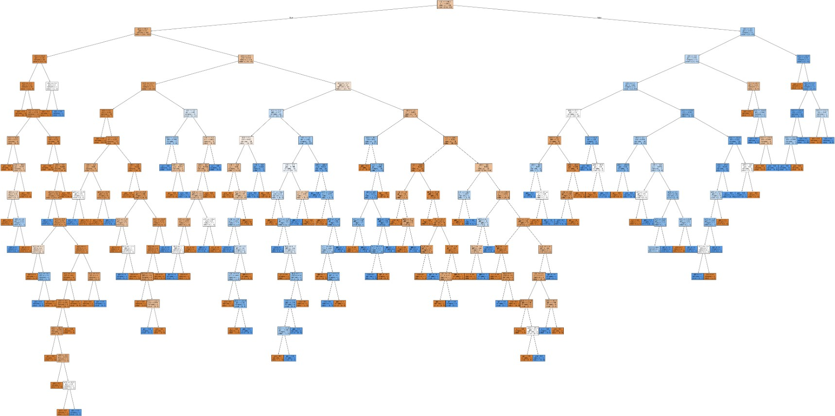
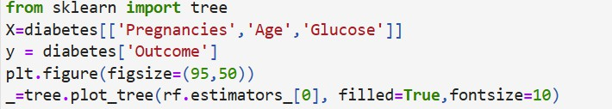
Create the Random Forest graph before Dask

Slide 16
Interpretation for the graph before dask
Each internal node represents a condition based on one of the features, such as Pregnancies, Age, or Glucose. For instance, a node might split on Glucose <= 120, meaning that if Glucose is less than or equal to 120, the data will go to the left child, and if greater, it will go to the right child. The terminal nodes show the predicted outcome, where 0 represents "no diabetes" and 1 represents "diabetes." These predictions are based on the majority class of the samples in each leaf node. The color of each node corresponds to the majority class at that node, helping to illustrate how the tree classifies individuals with different feature values.

Slide 17
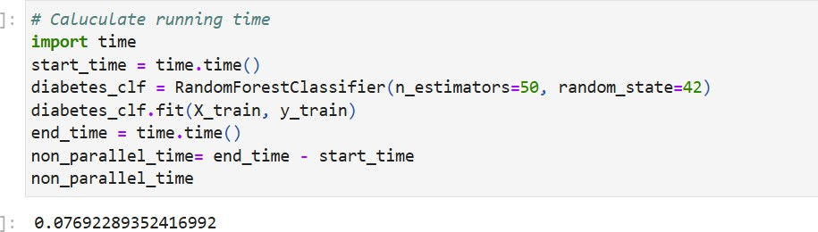
Interpretation:
The running time for training the RandomForestClassifier with 50 estimators on the diabetes dataset is approximately 0.077 seconds. This time shows how long it took to fit the model on the training data. It is the non-parallel time, meaning the model was trained using a single core and the computations were not spread across multiple processors or threads. For larger datasets or more complex models, using parallel processing could reduce the training time significantly.

Slide 18
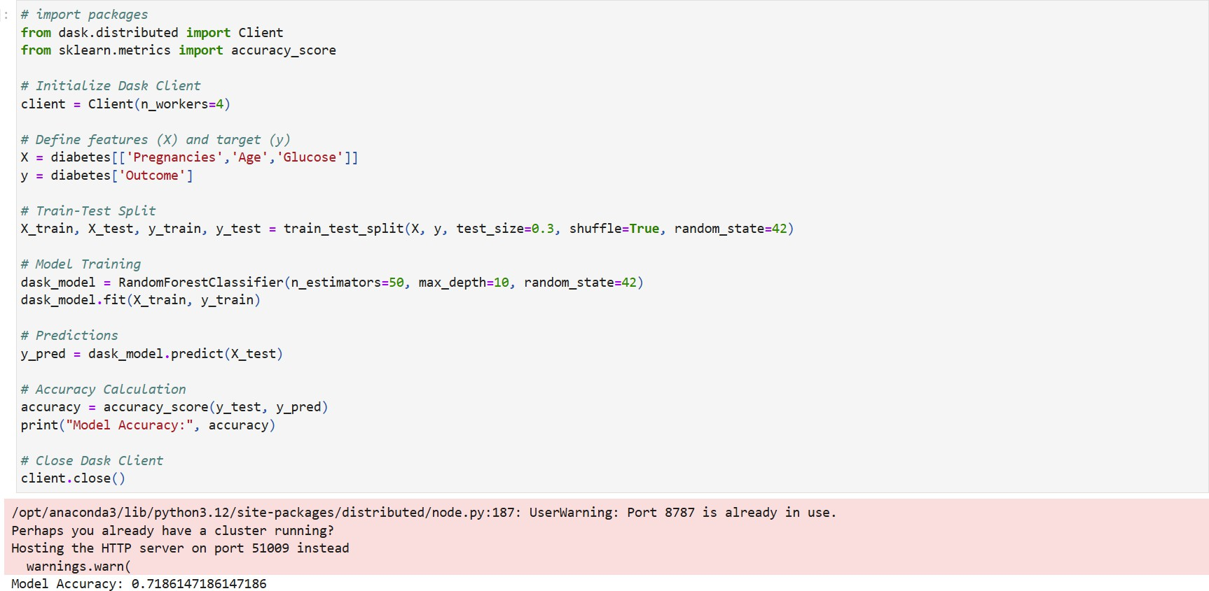
Interpretation:
Create the Random Forest graph after Dask and accuracy
It initializes a Dask Client with 4 workers and trains a RandomForestClassifier using Pregnancies, Age, and Glucose as features to predict diabetes (Outcome). After splitting the data into training and test sets, the model achieves an accuracy of 71.86%, meaning it correctly predicted diabetes outcomes for about 72% of the test samples. A warning appears about port 8787 being in use, but the process continues on a different port.
The Dask Client is then closed.

Slide 19
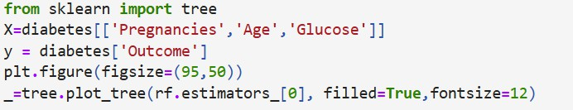
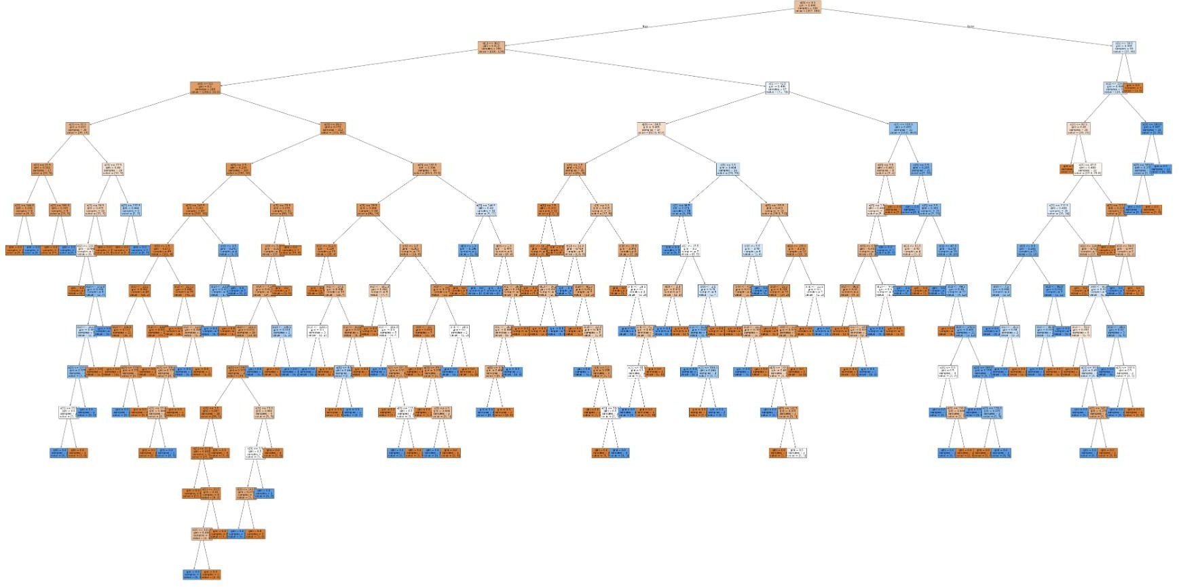

Slide 20
Interpretation:
The code visualizes the first decision tree from a Random Forest model trained on the diabetes dataset, using Pregnancies, Age, and Glucose as features to predict Outcome. The tree splits based on feature values, such as Glucose <= 120, and predicts diabetes (1) or no diabetes (0) at the leaf nodes. The plot is large for clarity, with colors representing the majority class at each node and a font size of 12 for better readability.|

Slide 21
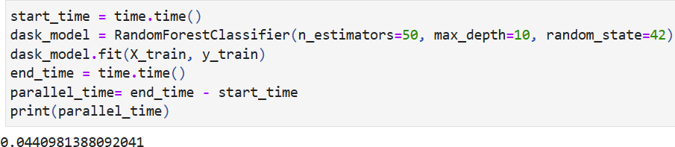
Running time
Interpretation:
It measures the training time of a RandomForestClassifier with 50 estimators and a maximum depth of 10, using the training data. The training process is completed in approximately 0.044 seconds. This is the parallel processing time, as the model is trained using multiple workers, which speeds up the process compared to training without parallelism. The value of 0.044 seconds indicates how long it took to fit the model with the given settings.

Slide 22
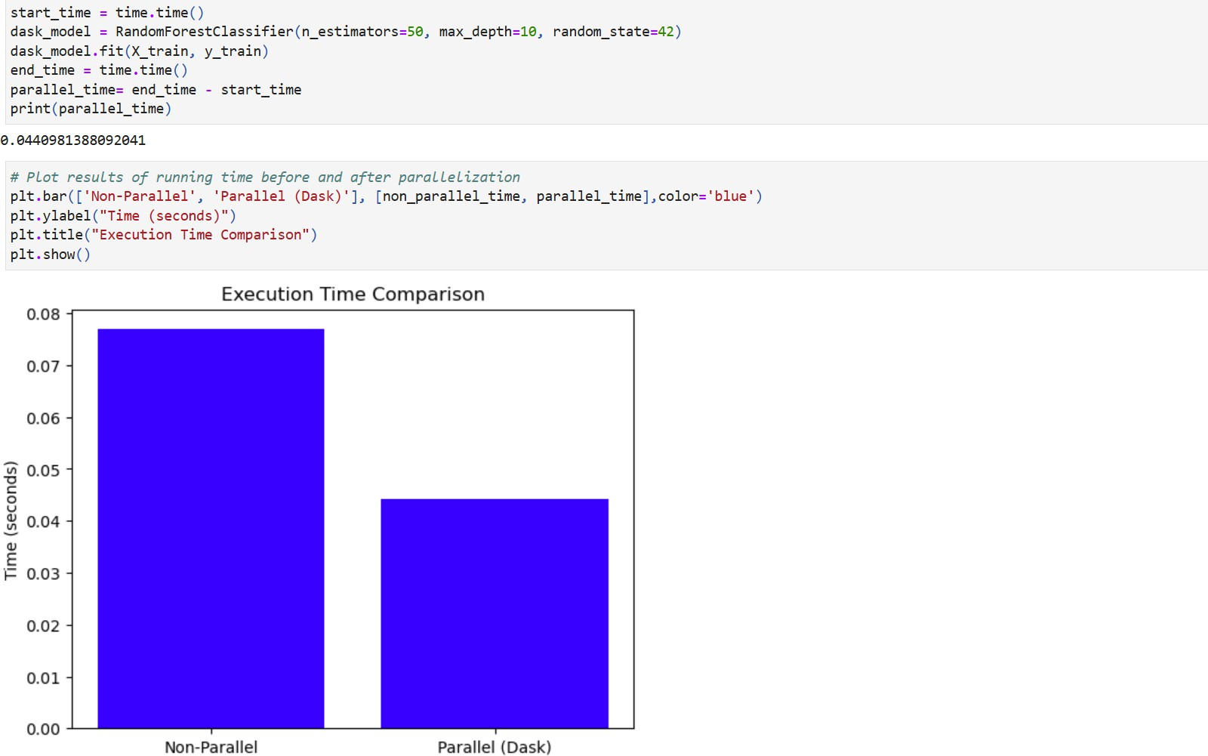
Which method was faster?

Slide 23
Interpretation:
Comparison run without parallelization versus using Dask for parallel execution:
The chart shows a comparison of execution times for a task run without parallelization versus using Dask for parallel execution. The non-parallel approach took about "0.076 seconds", while the parallelized version using Dask completed in "0.045 seconds". This means the parallel approach was significantly faster, reducing the execution time by nearly "42%". This improvement highlights the benefits of using Dask for handling computations more efficiently, especially for larger datasets where the speed-up can be even more noticeable.

Slide 24
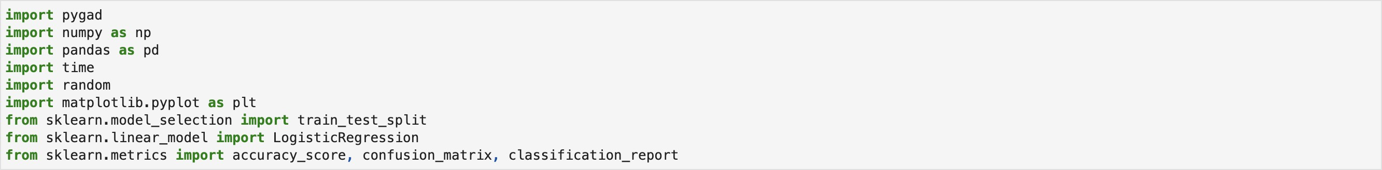
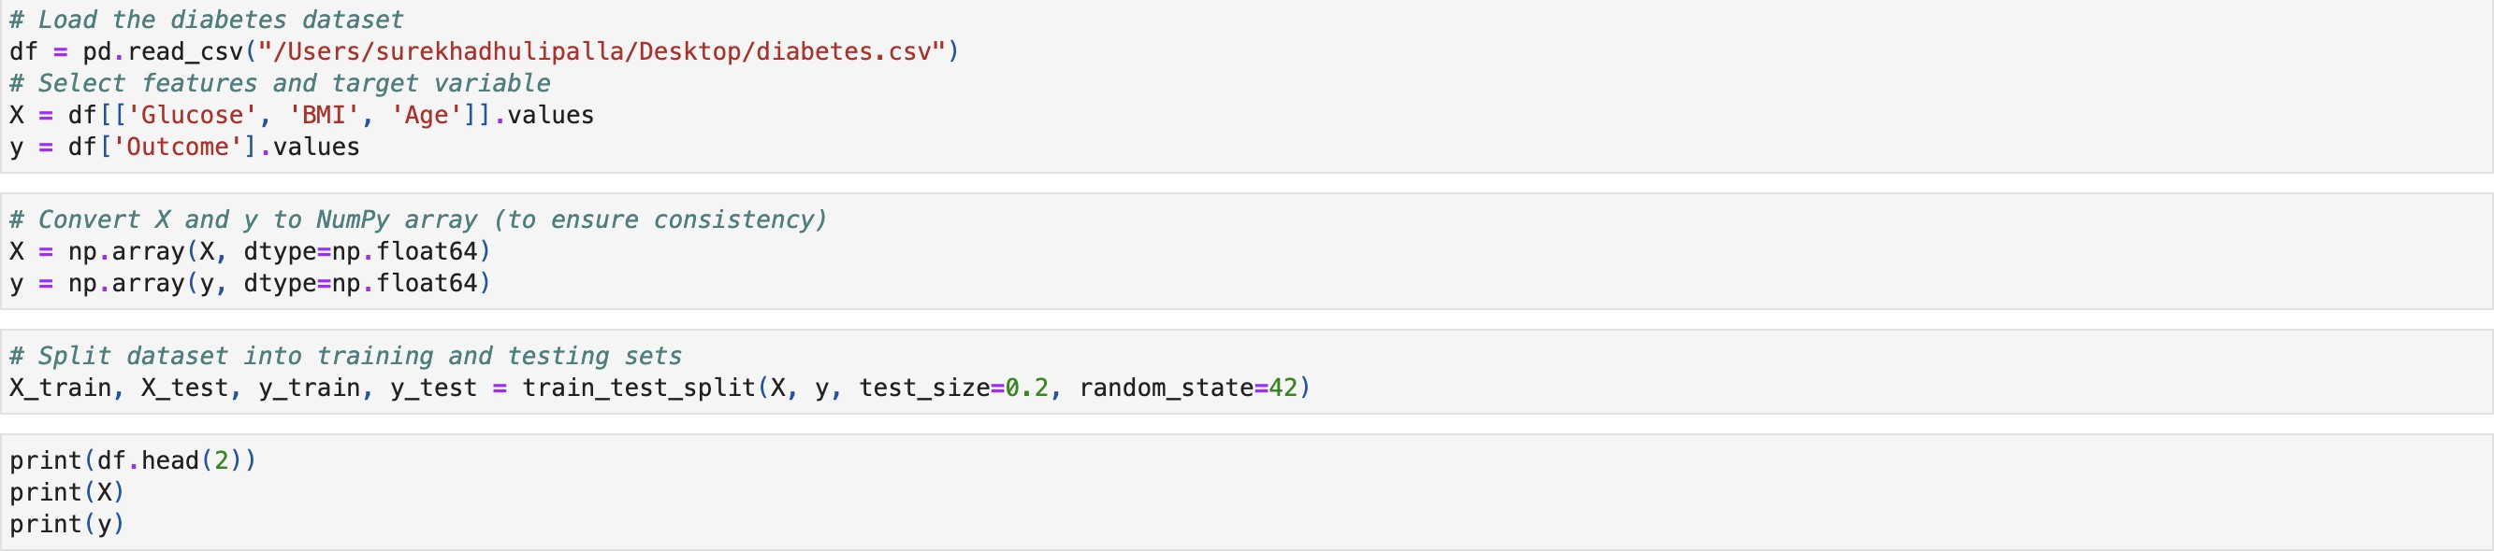
Select 2-3 features as X and one categorial feature for target
We selected Glucose, BMI , Age as X feature and Outcome as categorical feature

Slide 25
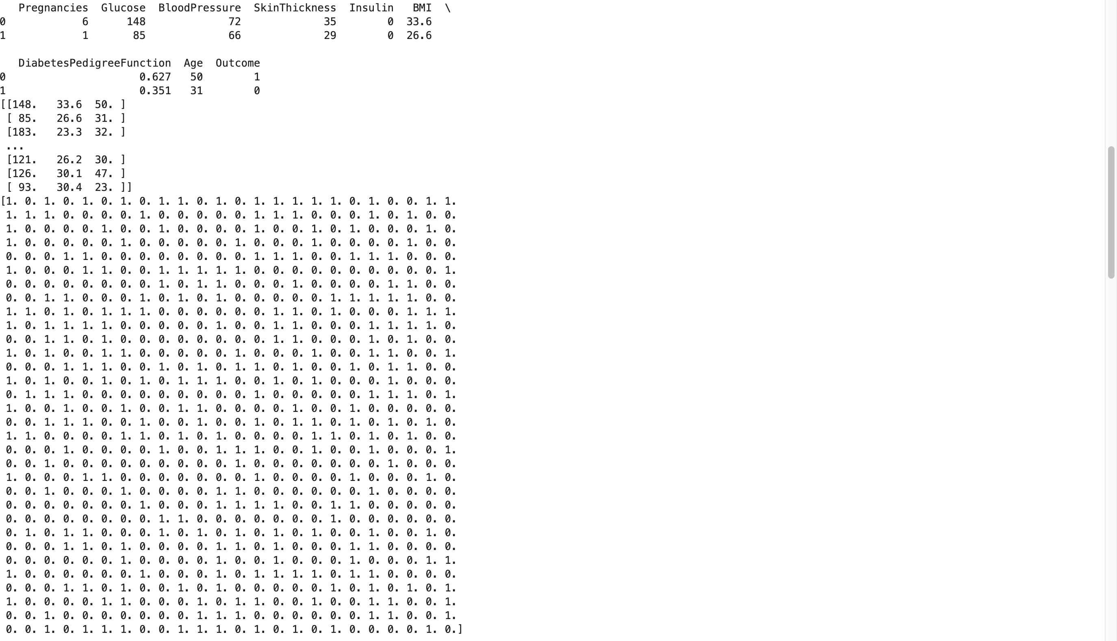
25

Slide 26
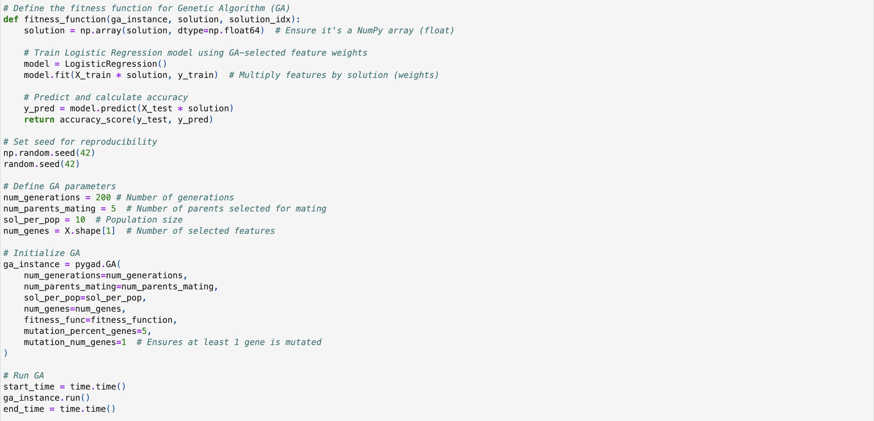
Genetic Algorithm for Feature Selection and Importance

Slide 27
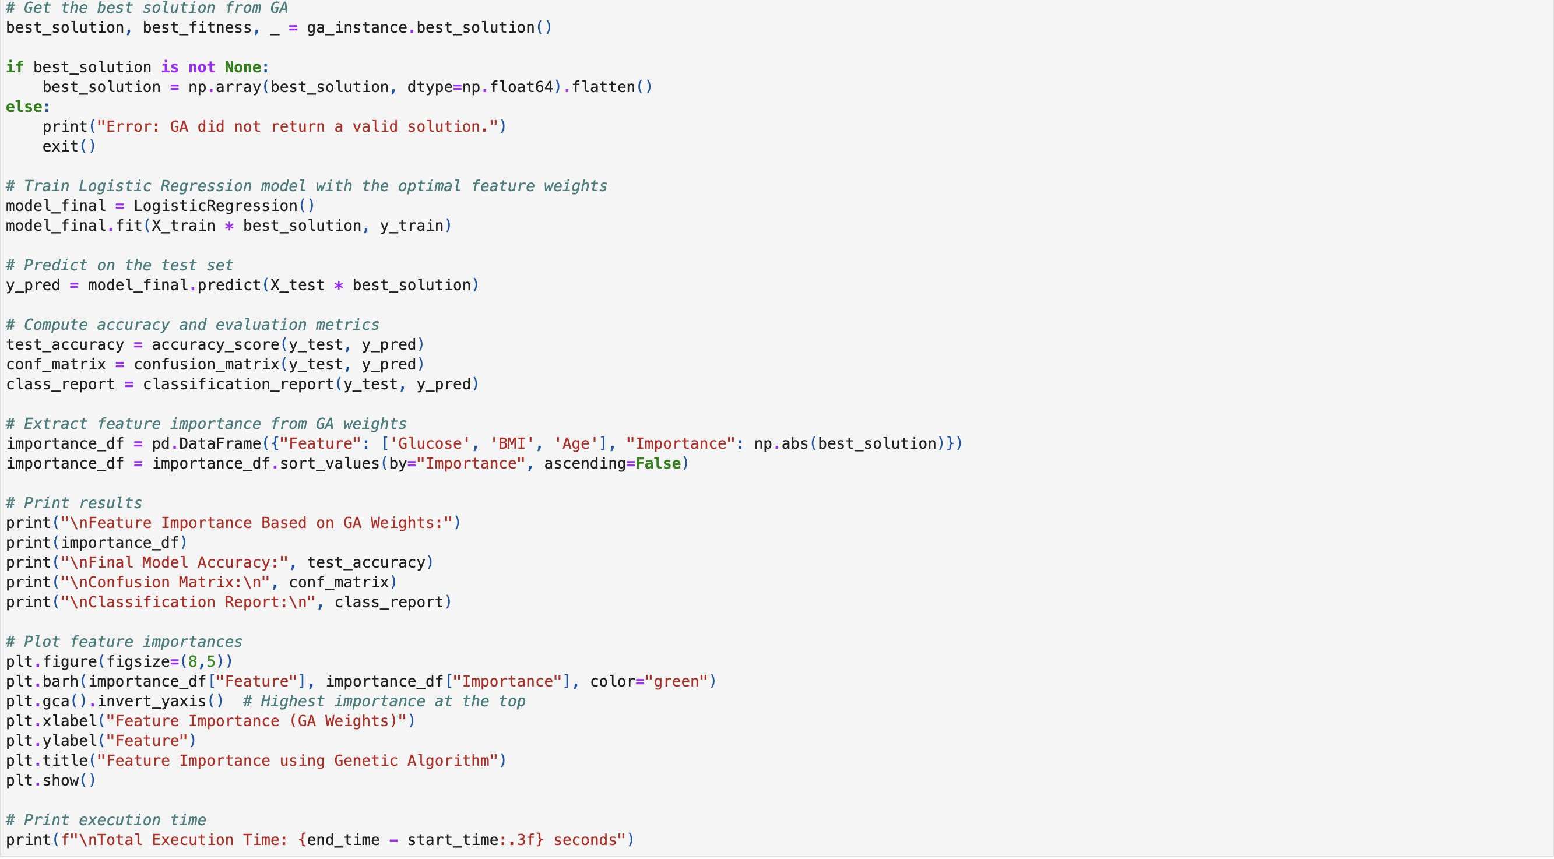
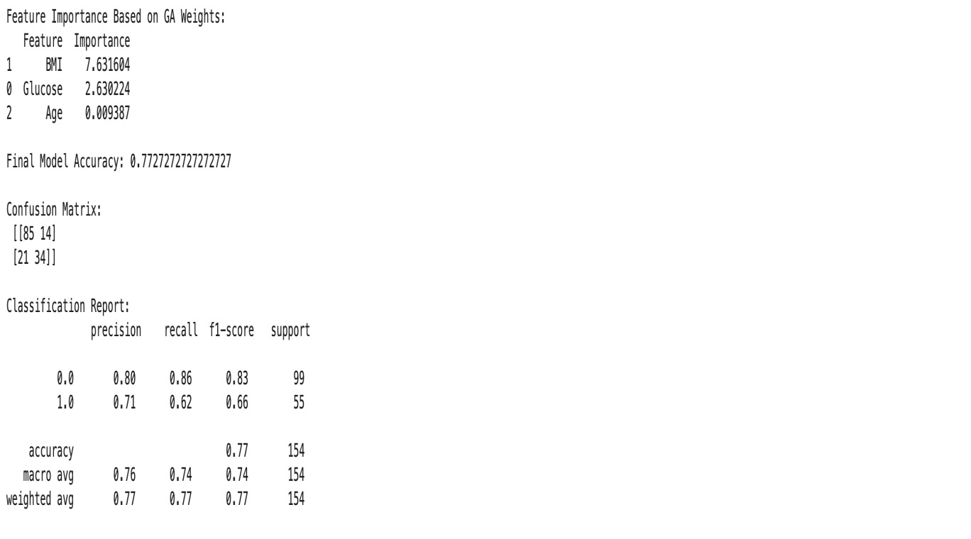
The result of feature importance shows BMI is the most influential predictor of diabetes Weight (7.63), followed by Glucose (2.63), while Age has minimal impact (0.009). The model achieved 77.27%(0.7727) accuracy, with 85 true negatives, 34 true positives, 14 false positives, and 21 false negatives. Precision for diabetes prediction was 71%(0.71), recall 62%(0.62), and F1-score 66%(0.66), while the model performed better for non-diabetic cases. This imbalance suggests the model could improve by better balancing the data.

Slide 28
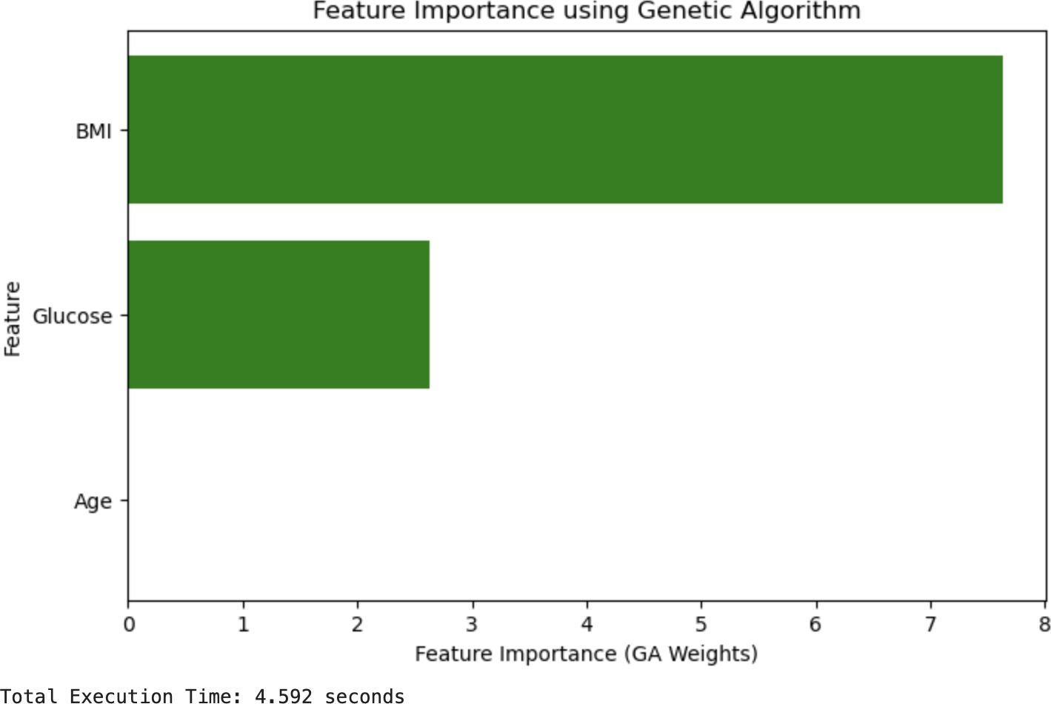
Bar Chart of Feature Importances
A bar chart visually highlights feature importance in diabetes prediction, showing that BMI (7.63) is the most significant factor, followed by Glucose (2.63), while Age (0.009) has almost no impact. The x-axis represents features, and the y-axis represents their importance weights. This visualization makes it clear that BMI plays the biggest role in the model’s predictions.
The Genetic Algorithm (GA) took 4.592 seconds to complete. The process took longer because it went through more generations to improve the feature weights for better accuracy.
28

Slide 29
Interpretation
The results clearly show that BMI is the most important factor in predicting diabetes, having a much stronger impact on the model than the other features. While Glucose is also important, it doesn’t have as much influence as BMI. Age, on the other hand, plays a very minimal role, making it less useful for predicting diabetes in this case. So, overall, BMI is the key feature for predicting diabetes.
29

Slide 30
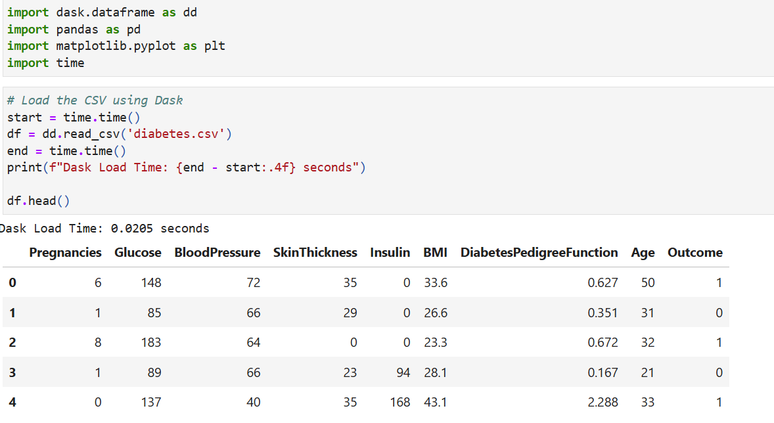
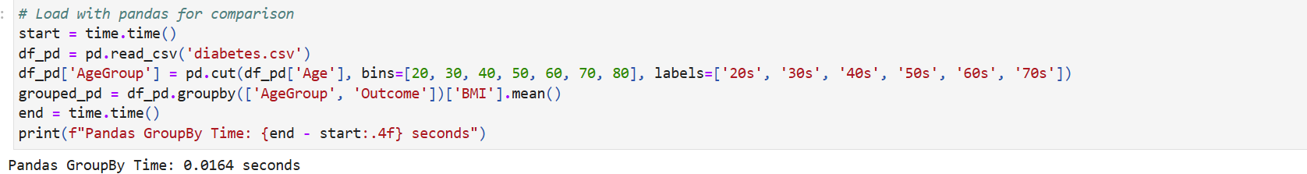
Dask Computing and pandas

Slide 31
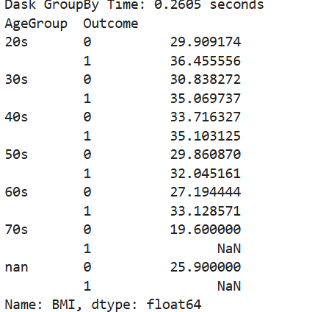
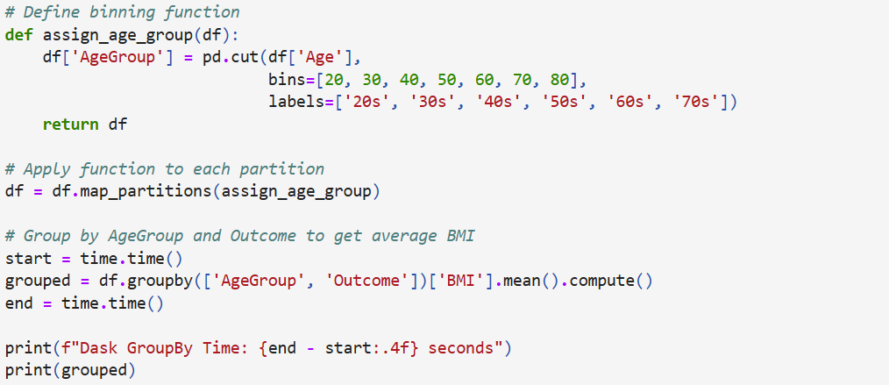
Select Features & Raise a Question:
Question: How does the average BMI vary across different age groups for diabetic vs non-diabetic patients?
Selected Features:
Age
BMI
Outcome

Slide 32
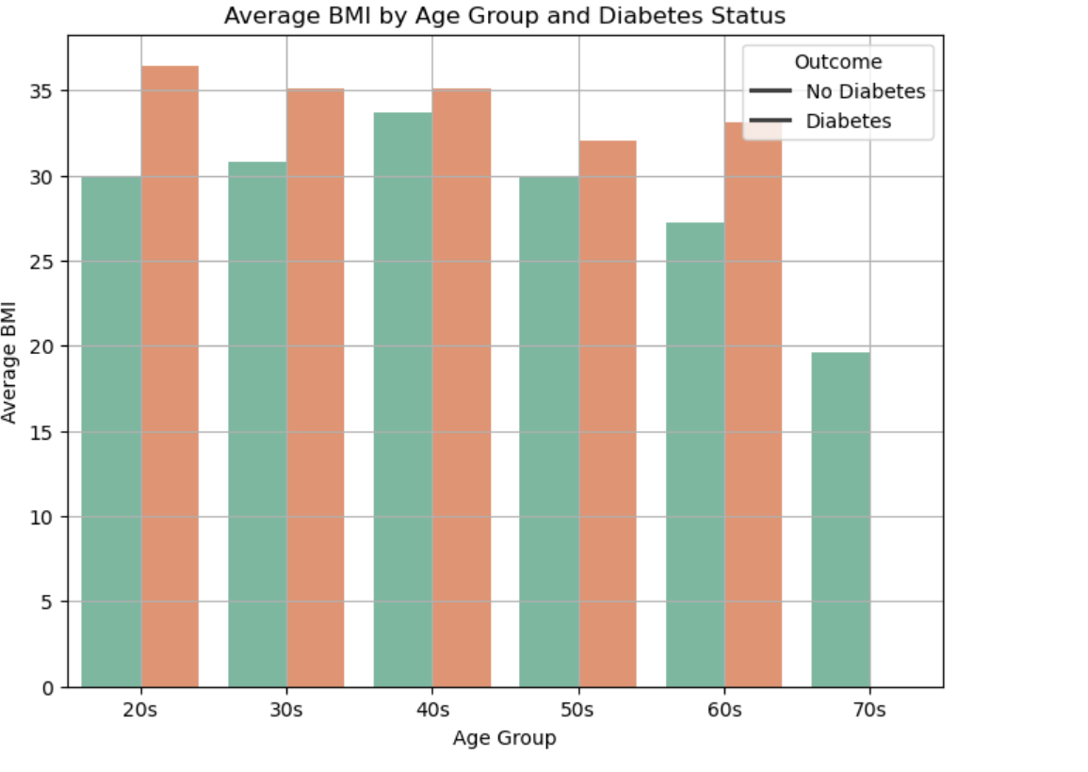
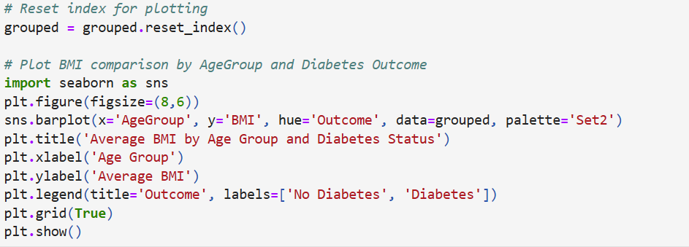
Dask visualization
Individuals with diabetes have a greater average BMI than those without it, regardless of age group. The variation in BMI is especially noticeable in younger age groups (20s and 30s).
The average BMI for both groups decreases as they age, particularly in their 60s and 70s.
There is no diabetes data for the 70s age group, implying that there are no diabetics or that there is a lack of data.

Slide 33
Interpretation:
In this study, we chose Age, BMI, and Outcome as the major features. Our research topic was: "Does the average BMI vary between diabetic and non-diabetic individuals across different age groups?" We used Dask to effectively analyze the data, which greatly reduced calculation time, with the group by operation taking only 0.2605 seconds to complete. We estimated each subgroup's average BMI using the group by function on Age Group and Outcome. Individuals with diabetes had a higher average BMI than those without diabetes across all age categories, with the discrepancy being most pronounced in the younger (20s) and older (60s) populations. This research provides a solid platform for visualizing trends and developing additional insights.

Slide 34
CONCLUSION:
Glucose, BMI, and Age were identified as important predictors of gestational diabetes, with BMI having the strongest impact.
Using fread() improved data reading efficiency, and Dask parallelization reduced model training time by approximately 42%.
Random Forest and Genetic Algorithm analyses confirmed that BMI is the most influential factor in diabetes prediction.
Diabetic individuals consistently exhibited a higher average BMI across different age groups, especially in their 20s and 60s.
Overall, optimized data handling and parallel computing significantly enhanced analysis speed, enabling faster and more accurate early diagnosis.

Slide 35


REFERENCES:
1. Akshay Dattatray Khare. Diabetes Prediction Dataset.
https://www.kaggle.com/datasets/akshaydattatraykhare/diabetes-dataset

Slide 36






CONTRIBUTION:
Surekha Dhulipalla: Collected a suitable dataset, defined the project scope, and created the initial presentation slides with data descriptions and column attributes.
Veena Chebrolu: Performed Linear Regression with and without profiling to compare feature importance and runtime using read.csv and fread. Added flame graph and performance interpretation to the slides.
Ramya Reddy Baapathu: Built Random Forest models before and after applying Dask for parallel processing. Compared model accuracy, runtime, and visualized results in the presentation.
Swaikshya Nepal: Applied Genetic Algorithm to determine feature importance and generated a bar chart of results. Analyzed model performance and interpreted the most significant features.
Neha Sri Tella: Formulated a data-driven question, used Dask with groupby for efficient analysis, and interpreted the grouped data results. Included visualizations and runtime improvements in the slides.

Slide 37
Thank you
Any questions ?

